Slide 1
Jupyter Notebook: An environment for reproducible and interactive code experiments
Nancy Soontiens
NAFC Computing Workshops
November 22, 2019

Slide 2
Overview
Motivation
Interactive computing vs scripts
Installing and using the jupyter notebook
Sharing notebooks
jupyter lab, binder and other neat tools
Resources

Slide 3
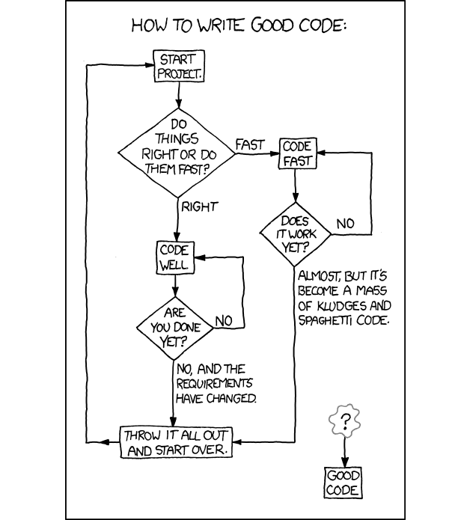
www.freecodecamp.org

Slide 4
Motivation
Science needs to be reproducible!
Jupyter notebook -> a digital lab report
Interactive
Plots, code, and notes all in one place
Can be saved and shared for reproducibility
Example from UBC Salish Sea NEMO Modelling Group
https://salishsea-meopar-docs.readthedocs.io/en/latest/index.html

Slide 5
Interactive computing vs scripts
 | Pros | Cons
Interactive computing | Immediate feedback Minimal overhead Fast to develop – debug as you go | Code can be lost or difficult to reproduce
Scripts | Code is recorded and can be reproduced | Some overhead to set up Can be difficult to debug
My typical workflow: develop interactively in a notebook and then translate to a script if needed

Slide 6
Introducing the jupyter notebook
Experiment with jupyter notebook with no installation!
https://jupyter.org/try

Slide 7
Installation - https://jupyter.org/install
Windows
jupyter notebook is available with Anaconda
Launch the notebook with Anaconda Navigator
Linux
If python is installed with Anaconda (recommended):
The jupyter notebook is included with your python distribution!
Launch the notebook with:
$ jupyter notebook
If python is installed with Miniconda:
$ conda install jupyter
$ jupyter notebook

Slide 8
Running the jupyter notebook on Windows
Open Anaconda Navigator
Launch jupyter notebook
A new window/tab will pop up in your web browser
Navigate to directory
Select New -> Python 3

Slide 9
Sharing notebooks
File -> Download as
nbviewer
https://nbviewer.jupyter.org/
Github
https://github.com/nsoontie/jupyter-notebook-lesson/blob/master/A%20quick%20introduction%20to%20the%20jupyter%20notebook.ipynb

Slide 10
Jupyter lab, binder and more
Example: Ocean Parcels
https://mybinder.org/v2/gh/OceanParcels/parcels_examples_binder/master?urlpath=lab/tree/parcels_examples/parcels_tutorial.ipynb

Slide 11
Resources
Jupyter
https://jupyter.org/
Software Carpentry Reproducible Research Lesson
https://reproducible-science-curriculum.github.io/workshop-RR-Jupyter/
Interesting articles on reproducibility and jupyter
https://arxiv.org/ftp/arxiv/papers/1810/1810.08055.pdf
https://thenewstack.io/jupyter-notebooks-challenge-reproducibility/

